Slide 1
Introductions to Operating Systems
Syed Shakil Mahmud
Lecturer
Department of Computer Science and Engineering
Bangladesh Army International University of Science and Technology
Presented by

Slide 2
What is an Software?
A program is a sequence of instructions that enables the computer to carry out some specific task.
Before a program executes, it has to be translated from its original text form (source program) into a machine language program. Then, the program needs to be linked and loaded into memory.
The software components are the collection of programs that execute in the computer.

Slide 3
What is an Software?
These programs perform computations, control, manage, and carry out other important tasks.
Two general types of software components are:
System software
Application software

Slide 4
System Software
The system software is the set of programs that control the activities and functions of the various hardware components, programming tools and abstractions, and other utilities to monitor the state of the computer system.
The system software forms an environment for the programmers to develop and execute their programs (collectively known as application software).
Examples: Operating System, Assemblers, Loaders, Linkers, Compilers, Editors

Slide 5
Application Software
Application software are the user programs and consists of those programs that solve specific problems for the users and execute under the control of the operating system.
Application programs are developed by individuals and organizations for solving specific problems.
Examples: Web browsers, MS Office, Excel, PowerPoint, etc.

Slide 6
System Software Vs Application Software
System Software | Application Software
System Software maintains the system resources and gives the path for application software to run. | Application software is built for specific tasks.
Low-level languages are used to write the system software. | While high-level languages are used to write the application software.
It is general-purpose software. | While it’s a specific purpose software.
Without system software, the system stops and can’t run. | While Without application software system always runs.
System software runs when the system is turned on and stops when the system is turned off. | While application software runs as per the user’s request.
Example: System software is an operating system, etc. | Example: Application software is Photoshop, VLC player, etc.
System Software programming is more complex than application software. | Application software programming is simpler in comparison to system software.

Slide 7
What is an Operating System?
A large and complex software component for the operation and control of the computer system.
It acts as an intermediary between a user and the computer system.
Examples: Unix, MS Windows, MacOS, Linux, Sun Solaris, DEC VMS, etc.
A provider of services to user programs.
A huge resource manager.

Slide 8
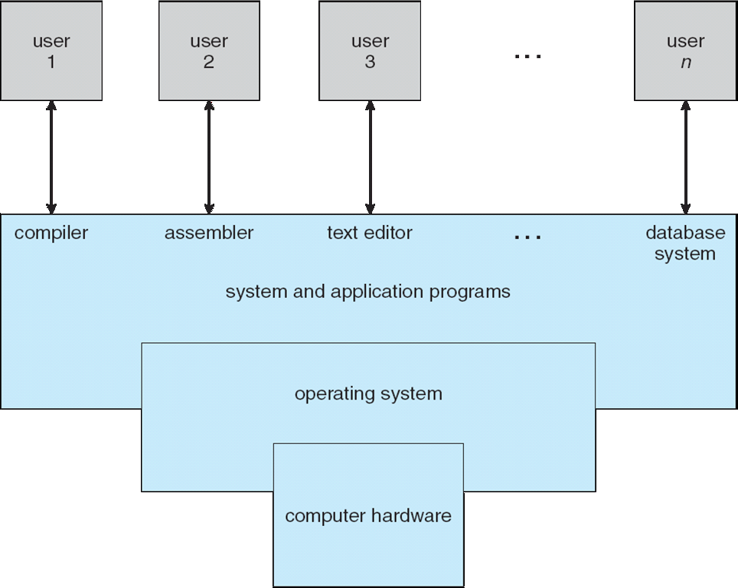
What is an Operating System?

Slide 9
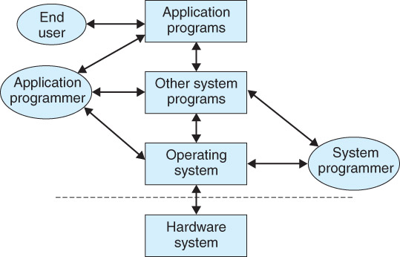
External View of a Computer

Slide 10
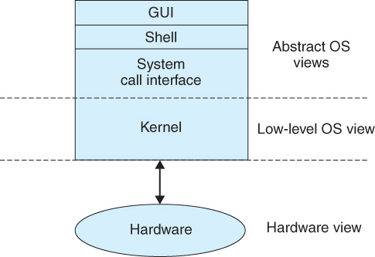
Abstract View of an OS

Slide 11
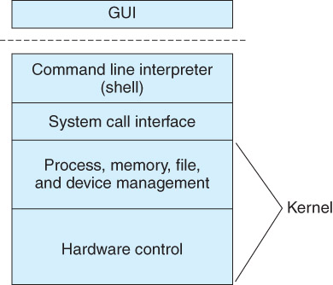
Basic Structure of an OS

Slide 12
Operating Systems User Interfaces
Three levels of interface:
Graphics GUI (windows oriented)
Command level (also known as the shell). At login time, the shell starts computing. The program that handles user interaction with the system is called Shell.
System calls invoked from user programs.

Slide 13
Design Goals of an Operating System
User goals: The operating system should be
Convenient to use,
Easy to learn,
Reliable,
Safe, and fast.
System goals: The operating system should be
Easy to design,
Implement, and maintain,
As well as flexible,
Reliable,
Error-free, and
Efficient.

Slide 14
Different Types of Operating System
There are several types of operating systems, each designed for specific types of hardware and user needs. Here are some of the most common types:
Batch Operating System: This type of operating system does not interact with the computer directly. There is an operator which takes similar jobs having the same requirement and groups them into batches.
Multi-Programming System: Multiprogramming Operating Systems can be simply illustrated as more than one program is present in the main memory and any one of them can be kept in execution.
Multi-Processing System: Multi-Processing Operating System is a type of Operating System in which more than one CPU is used for the execution of resources.

Slide 15
Different Types of Operating System
Multi-Tasking Operating System: A multi-tasking operating system allows more than one program to run concurrently. In a time-sharing system, this is achieved by multitasking.
Time-Sharing Operating System: Time-sharing or multitasking is a logical extension of multiprogramming. The CPU executes multiple jobs by switching among them, but the switches occur so frequently that the users can interact with each program while it is running.
Distributed Operating System: Distributed systems use multiple central processors to serve multiple real-time applications and multiple users2. Data processing jobs are distributed among the processors accordingly.

Slide 16
Different Types of Operating System
Network Operating System: A Network Operating System runs on a server and provides the server the capability to manage data, users, groups, security, applications, and other networking functions.
Real-Time Operating System: A real-time system is defined as a data processing system in which the time interval required to process and respond to inputs is so small that it controls the environment. The time taken by the system to respond to an input and display of required updated information is termed as the response time.

Slide 17
Functions of Operating System
Here are some of the main functions of an operating system:
Memory Management: The OS manages the primary or main memory. It keeps track of which bytes of memory are used by which user program. It allocates and deallocates memory to processes and ensures that other processes do not consume the memory allocated to one process.
Processor Management/Scheduling: The OS determines the status of the processor and processes, selects a job and its processor, allocates the processor to the process, and de-allocates the processor after the process is completed. When more than one process runs on the system, the OS decides how and when a process will use the CPU

Slide 18
Functions of Operating System
Device Management: The OS manages all the device communication via their respective drivers. It does the job of receiving the I/O requests from a device, error handling, and buffering.
File Management: The OS provides a way for the user to create, delete, read, write, and reposition files. It also ensures that the files are organized in an efficient manner, and they are easy to access.
Security and Access Control: The OS prevents unauthorized access to programs and data by means of passwords and similar other techniques. It also protects data from physical damage (by redundancy) and data loss (by backups)

Slide 19
Functions of Operating System
Job Accounting: Keeping track of time and resources used by various jobs and users.
Control over system performance: Recording delays between request and response.
Interaction with the users: The OS interacts with the user through command-line interface (CLI), graphical user interface (GUI), or batch interface.
Defense of the system against internal and external attacks: Huge range, including denial-of-service, worms, viruses, identity theft, theft of service

Slide 20
Functional Components of an OS
The most important components of an operating system are:
Process manager
Memory manager
Resource manager
File manager
Device manager

Slide 21

Questions?

